Slide 1

Design and implementation of Signed divider
by Suraj Patil 01FE21MVE005
SIGNED DIVIDER
09-05-2022

Slide 2

Problem Statement
Flowchart
Architecture
Code

Slide 3

SIGNED DIVIDER
The division operation has to be in the binary.
In Unsigned binary division by default we use positive binary number.
In Signed binary division we use both positive binary and we have to find negative equivalent binary
Unsigned – positive – (19) – 00010011
Signed – positive – (6) – 00000110
- negative – (-6) - ?
2’S COMPLEMENT of (00000110) (-6)
negated value (11111001)
+ 1
(11111010)

Slide 4

Example 19 divide by 6
(19) 0001 0011
(-6) + 1111 1010
(13) 0000 1101 q=1
Still 6 is smaller then 13
(13) 0000 1101
(-6) + 1111 1010
(7) 0000 0111 q=0010
Still 6 is smaller then 7
(7) 0000 0111
(-6) + 1111 1010
(1) 0000 0001 rem=01 quo=0011

Slide 5
start
Dividend
Divisor
If
DIVISOR IS -VE
If
DIVIDEND IS -VE
NO
MAKE VALUE NEGATIVE
NO
NO
2S COMPLEMENT OF DIVISOR
yes
yes
BINARY ADDING
DIVIDEND+DIVISIOR
2S COMPLEMENT OF DIVISOR
2S COMPLEMENT OF DIVIDED
REMINDER & QUOTIENT
NO
If
QUOTIENT IS -VE
BINARY EQUIVALENT QUOTIENT
yes
STOP
2S COMPLEMENT OF QUOTIENT

Slide 6

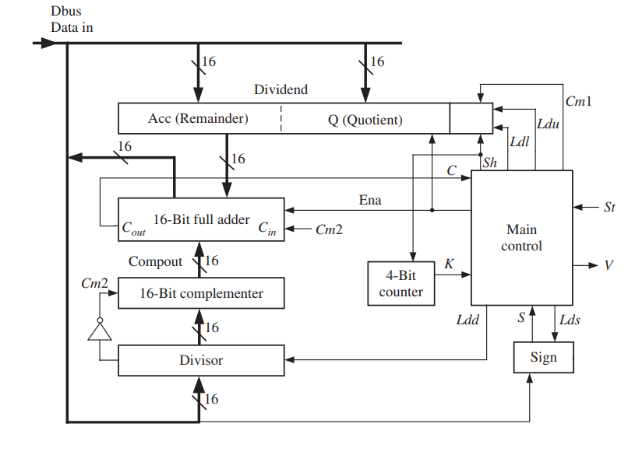

Slide 7

Module signed divider ( databus, quotient, remainder, divisor, dividend, clk)
Input databus [15:0];
Input divisor [15:0];
Input dividend [15:0];
Output remainder [15:0];
Output quotient [15:0];

Slide 8
THANK YOU

